Slide 1

Disasters in the US
By Rachel Harbert, Owen Curtis, Naoufal Rhioui, Hussam Busfar

Slide 2
Overview
Objectives
Data
& Modeling
Visualization
Toolkit
Small Business
Deep Dive
Next Steps
Notes:
Our overview for today is to go over our objectives, the data sources and steps we took to collect the data, modeling the estimated FEMA costs for providing relief to homeowners, building a visualization toolkit for relief effort prioritization, Small Business Administration Loans, and ideas for next steps.

Slide 3
Objectives
Problem
Relief Effort Geo-Prioritization
Small Business Support
Solution
Toolkit to help isolate for zip codes likely to require most Federal assistance
Approach to identify impacted areas in need of additional SBA loan support
Notes:
Our objective was to evaluate the financial needs of those who are impacted by disasters. We approached this objective in two different ways.
First we looked at which areas FEMA should prioritize when providing financial aid. We came-up with a Toolkit that isolates zip codes that are more likely to require assistance.
The second is to explore which areas the Small Business Administration should focus more on in relation to impact to communities from disasters.

Slide 4
Data Processing: Sources
FEMA Disaster Support API
Timeframe: 2004 to Present
Granularity: Zip code
Details:
Disaster Code
FEMA Registrations
Total Damage
Approved Support ($)
Notes:
We used a total of four sources to pull together data for this analysis.
The first was to use the Federal Emergency Management Agency’s (or FEMA) housing assistance API. We were able to get close to 90,000 rows in a few minutes that had data from 2004 to the present. The data provided granularity by zip code level. The data that we used includes the disaster code, the number of FEMA registrations by zip code, the total home damage recorded by FEMA at the time of inspection, and the total approved amount under the individuals and household program that includes the repair and replace amount for the home, any rental assistance if they cannot be in their home, and any other needs such as medical or transportation. The individual and household program (IHP) provides financial and direct assistance to people who, as result of a disaster, have necessary expenses and serious needs that are not met through insurance or other means.

Slide 5
Data Processing: Sources
FEMA Disaster Support API
FEMA Disaster Details API
Timeframe: 2004 to Present
Granularity: Disaster code
Details:
Incident Type
Start, End Dates
Notes:
The FEMA disaster details were pulled from the API to gather data from 2004 to present. The granularity was by disaster code. Each disaster code provided the incident type (such as hurricane, flood) as well as the start and end dates for each disaster.

Slide 6
Data Processing: Sources
FEMA Disaster Support API
FEMA Disaster Details API
Census Bureau
Timeframe: 2006 to 2010
Granularity: Zip code
Details:
Average Income
Median Income
Population
Notes:
We used Census Bureau data to gather the mean and median income as well as population for each zip code.

Slide 7
Data Processing: Sources
FEMA Disaster Support API
FEMA Disaster Details API
Census Data
Small Business Administration
Timeframe: 2004 to present
Granularity: Zip code
Details:
Approval amount
Notes:
We gathered data from the Small Business Administration on their 504 loans from 2004 to present. The 504 loans are typically used to buy commercial real estate or large equipment. We used the SBA approval amount by zip code.

Slide 8
Merging
Skip functionality
FEMA Disaster Support API
FEMA Disaster Details API
Census Bureau
Small Business Administration
Disaster Number
Zip code
Zip code, Date
Notes:
Using these four datasets, we merged them together to gather interesting insights into the data.

Slide 9
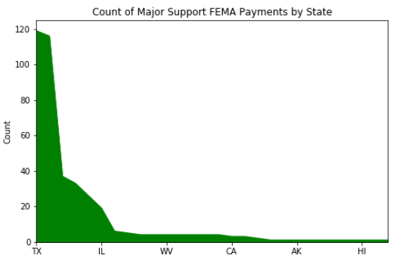
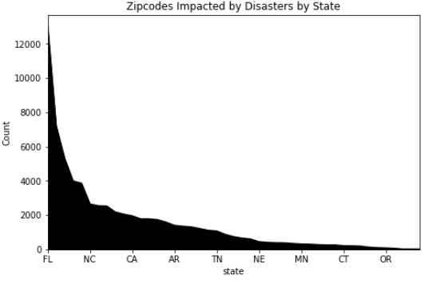
State Level Support vs Impact

Slide 10
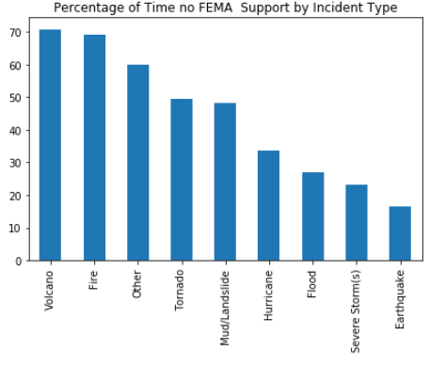
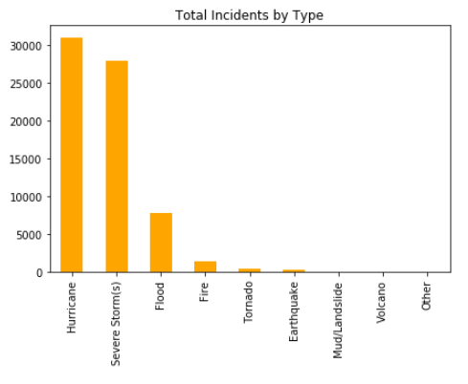
Where can FEMA help more?
Impacted Zipcodes by Disaster Type

Slide 11
Predicting FEMA Support
Cleaning
Feature
Engineering
Model
Selection
Validation
Low Sample Disaster Types
Low Sample States/Territories
Feature Scaling
Disaster historicals
Economic indicators, pop size
Disaster Duration
Linear Reg, KNN, Dec Tree, Bagging, Random Forest, Adaboost
WINNER: KNN
R^2
Train: .80
Test: .81

Slide 12


Putting it All Together
Predicted FEMA Support
Visualization
Toolkit

Slide 13
Visualization Toolkit
Tableau
Use Cases
Zipcode
Explorer
Forecasted
Impact
Explorer
SBA Loan
Deep Dive
Wildfires are spreading in California. which zipcodes are likely to need federal support?
A hurricane is tracking to impact Coastal Florida. What is the predicted support from FEMA by zipcode?
Outside of FEMA, where might the SBA be focusing their efforts to stabilize local economies post-impact?

Slide 14

Relief Amount vs SBA 504 Loans
FEMA Relief Amount Rank | State | SBA 504 Loan Amount (mm) | Loan % of Total | SBA 504 Loan Rank | Loan Count | FEMA Relief Amount (mm) | FEMA % of Total | Disaster Count
1 | LA | 338 | 0% | 41 | 500 | 3,438 | 28% | 11
2 | TX | 5,007 | 7% | 3 | 5,876 | 2,329 | 19% | 19
3 | FL | 5,430 | 7% | 2 | 8,705 | 1,730 | 14% | 18
4 | NY | 3,001 | 4% | 5 | 3,961 | 988 | 8% | 12
5 | MS | 221 | 0% | 45 | 222 | 800 | 6% | 15
6 | IL | 3,710 | 5% | 4 | 5,374 | 495 | 4% | 10
7 | AL | 809 | 1% | 24 | 1,313 | 302 | 2% | 12
8 | NC | 1,103 | 1% | 22 | 1,797 | 232 | 2% | 8
9 | PA | 1,297 | 2% | 18 | 1,727 | 221 | 2% | 6
10 | IA | 713 | 1% | 26 | 1,362 | 170 | 1% | 5
Notes:
Louisiana has received $3.4bn in relief amount from FEMA from 2004 to present day. During that time period, they have only received $338mm in SBA loans, coming in 41st out of 50 states. Mississippi as well has only gotten $221mm in loans but is also the 5th highest state in terms of disaster impact on homes.

Slide 15
Next Steps
Toolkit
Integration of dashboard with live feed (FEMA APIs)
Model Refinement/Predictive Tool Enhancements
SBA
Deeper dive into SBA disaster loan data at zipcode level

